Slide 1
The DOM
The Document Object Model

Slide 2

The Dom
The DOM (document object model) represents the structure through which a web page is designed.
It is a hierarchical structure through which HTML elements share
a parent/child
relationship.

Slide 3
The Dom
The document itself (<html>), is the root element.
In javascript, it can be accessed directly.

Slide 4
The Dom
The <head> is a direct child of the document.
The <body> is a direct child of the document.

Slide 5
The Dom
Each of the other elements is a child of the <body> or <head>
Any element on the page can be a parent as well.

Slide 6
The Dom
Other objects on the page are also part of the structure.
This may include attributes or even simple text.

Slide 7
Nodes
In order to accomplish this, the designers of the DOM had to use some sophisticated data structures. The individual elements of the structure are called NODES.
A node is a construct that holds a piece of data (which can be simple, like a number, or complex, like an object). A node also has one or more pointers to its most immediate family members.

Slide 8
Nodes
This diagram represents a node with a single pointer. The pointer is an object that corresponds to the node’s child.
NODE
DATA

Slide 9
Nodes
This diagram represents a chain of nodes or a Linear Linked List. Each single node in the list knows only who its child is. It knows nothing about its parent.
The end of the list is indicated by a null, showing that the final node has no child.
NODE
DATA
NODE
DATA
NODE
DATA
null

Slide 10
Nodes
Other nodes can be much more complicated, having pointers that point to multiple children, parents, siblings, or any combination of them.
NODE
DATA

Slide 11
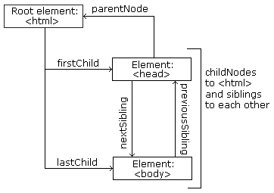
DOM Nodes
The DOM makes use of these complicated types of nodes.
Every HTML Element is a node.

Slide 12
Dom nodes
We can access vital information through the use of the node properties. All nodes share these properties and are accessible through the dot (.) operator.
parentNode - the parent node of the element
childNodes – a list of the child nodes of the element
firstChild – the first child node of the element
lastChild – the last child node of the element
nextSibling – the next sibling of the element
previousSibling – the previous sibling
attributes – a list of the attributes nodes of the element

